Slide 1
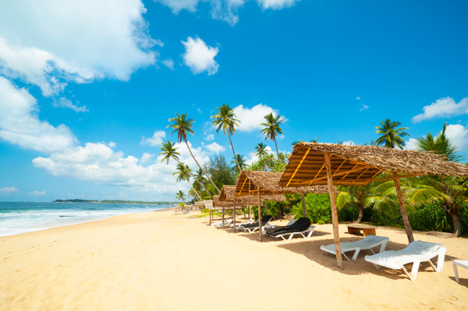


SCS 2102 GROUP PROJECT -01 CS GROUP- 29

Slide 2

Our..
Supervisor
Mr. Rangana Jayashanka
Co-supervisor
Ms. Kamsa Sharma
Team-Members
R. P. Ranaweera - 18001327
W. T. Gihan - 18000576
G. G. N. N. Wanigasekara - 18001823
H. M. D. Thathsara - 18001696

Slide 3
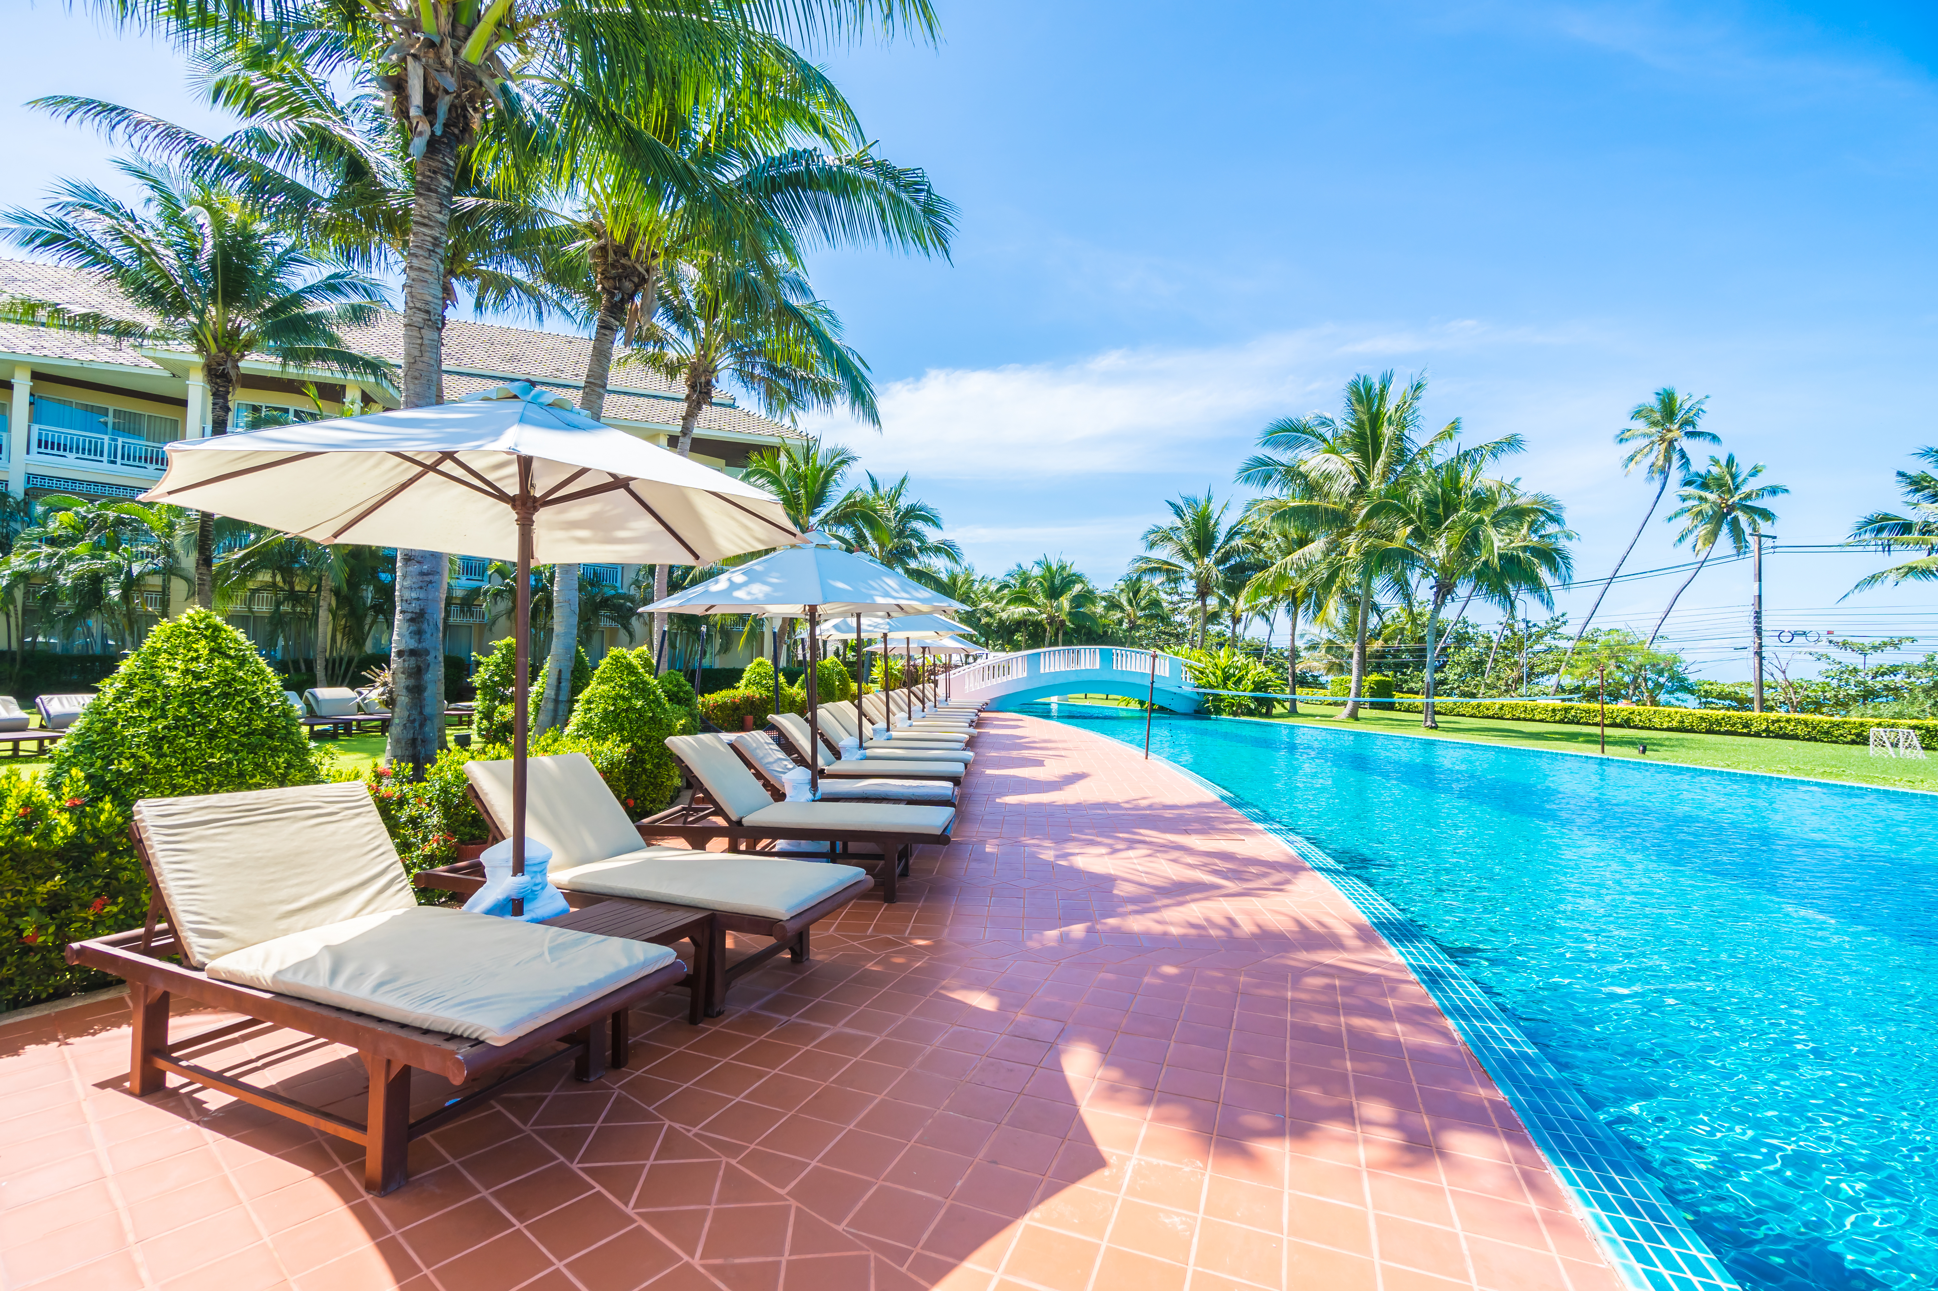
Our Client…
Mr. Indigahawalage Sudeera
No:502,Bypass Rd,Weligama.
+94-76 729 3945
bayfrontwell45@gmail.com
Bay Front

Slide 4
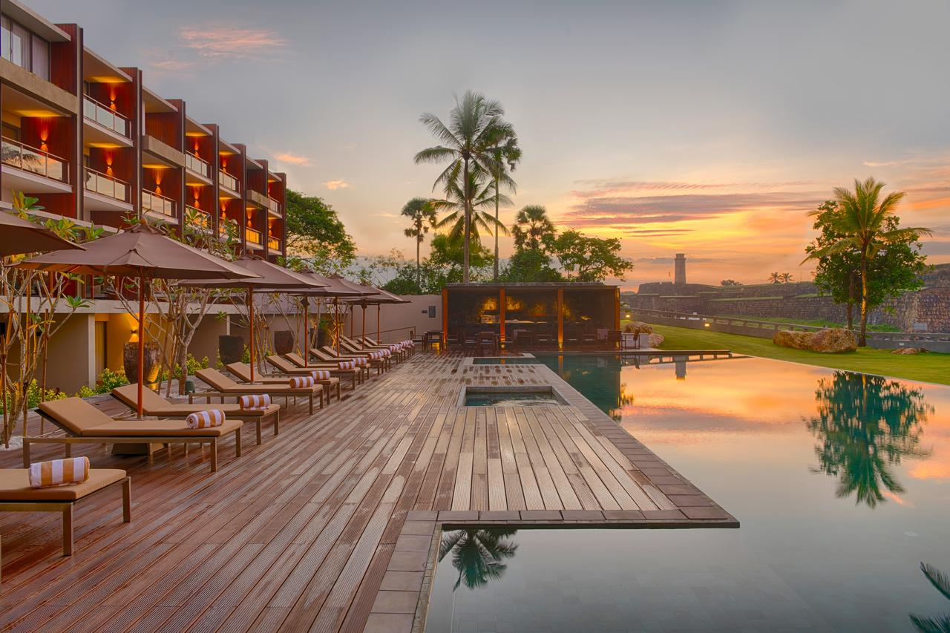
Introduction
4

Slide 5

‘Hotel Bay-front’ is one of the famous hotels in southern coast-line. But this hotel is currently using a manual system.
The problems they currently face are ,making reservation process manually, all information is stored in a file-based system, problems with money transaction, Inability to manage customer information properly, Poor communication with customer.
,

Slide 6

Goal
Creating a web-based system for our client to maintain a good customer relationship and make a secure online environment for the hotel.

Slide 7

Solutions…
Online reservation System.
Online payment system.
Establish a systematic database of all customer details
Notification System
Generate the Reports
Easy to access system

Slide 8



Actors of Bay-Front
Customer
Receptionist
Owner/Admin

Slide 9

SYSTEM ARCHITECTURE

Slide 10





MVC Architecture
Operations
Db
Model
Manipulates and retrieves data
Updating and user requests
View
Controller
Interacts/sees
Uses/gives input
Users
Receptionist
Admin/Owner
Customer

Slide 11
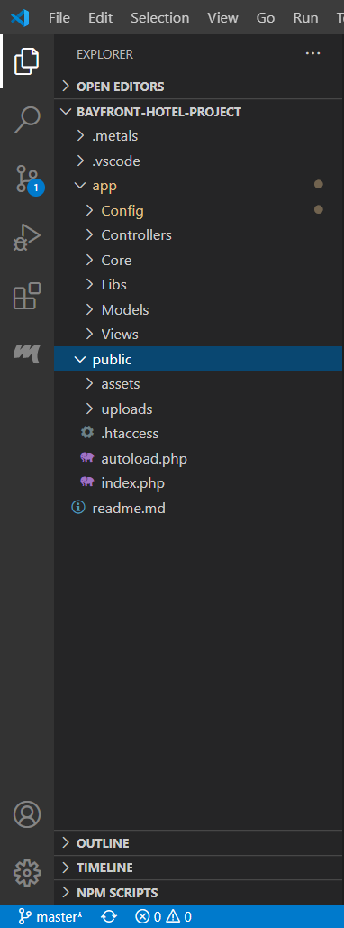
Folder architecture is completed.
Hence,
Faster development process
Effective use of resources
The modification does not affect entire model

Slide 12
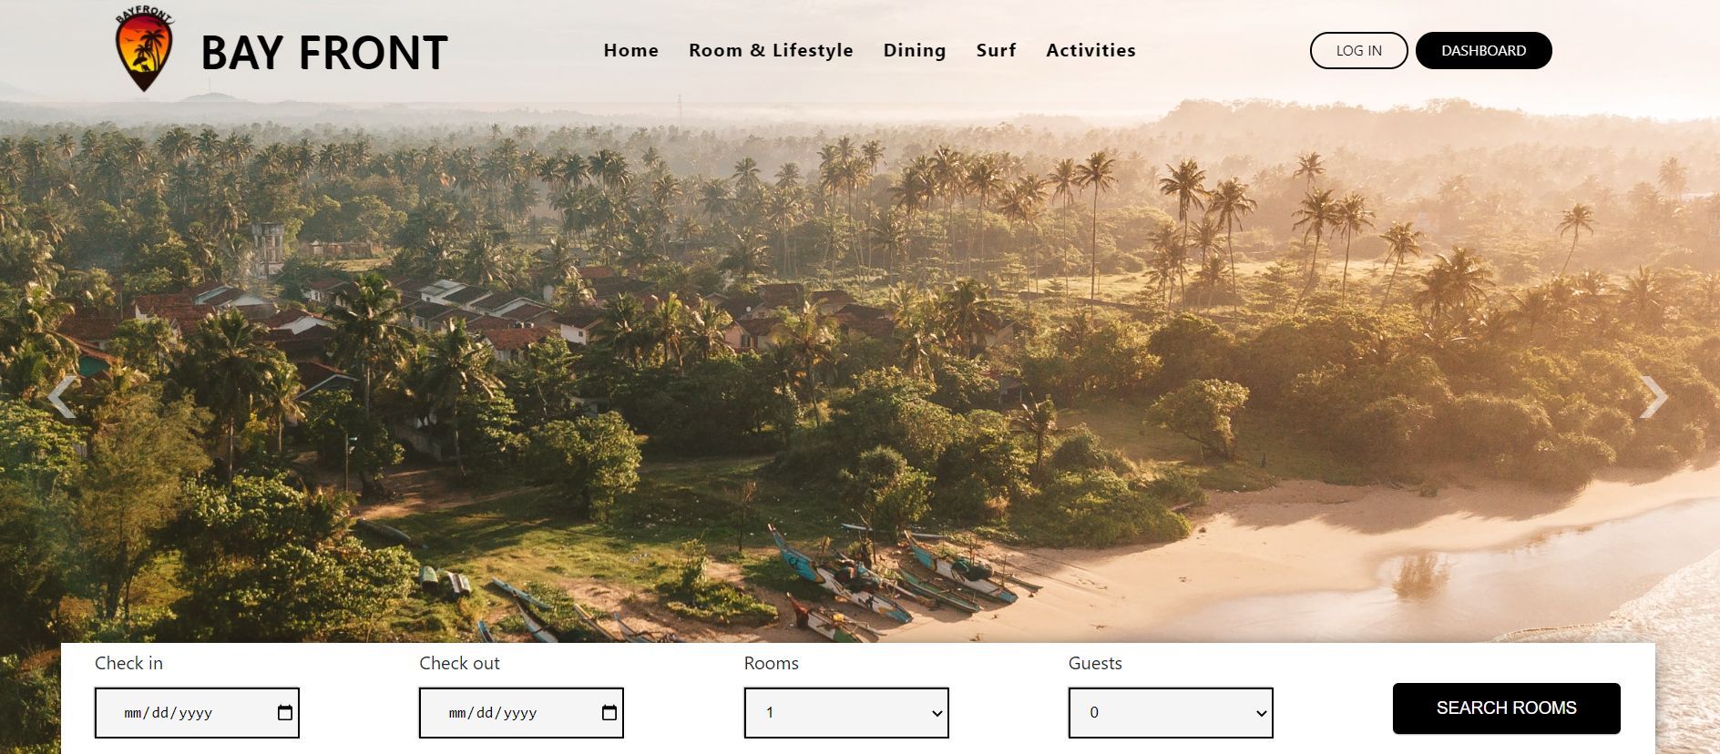
Interfaces
Every UI is completed and ready to view

Slide 13
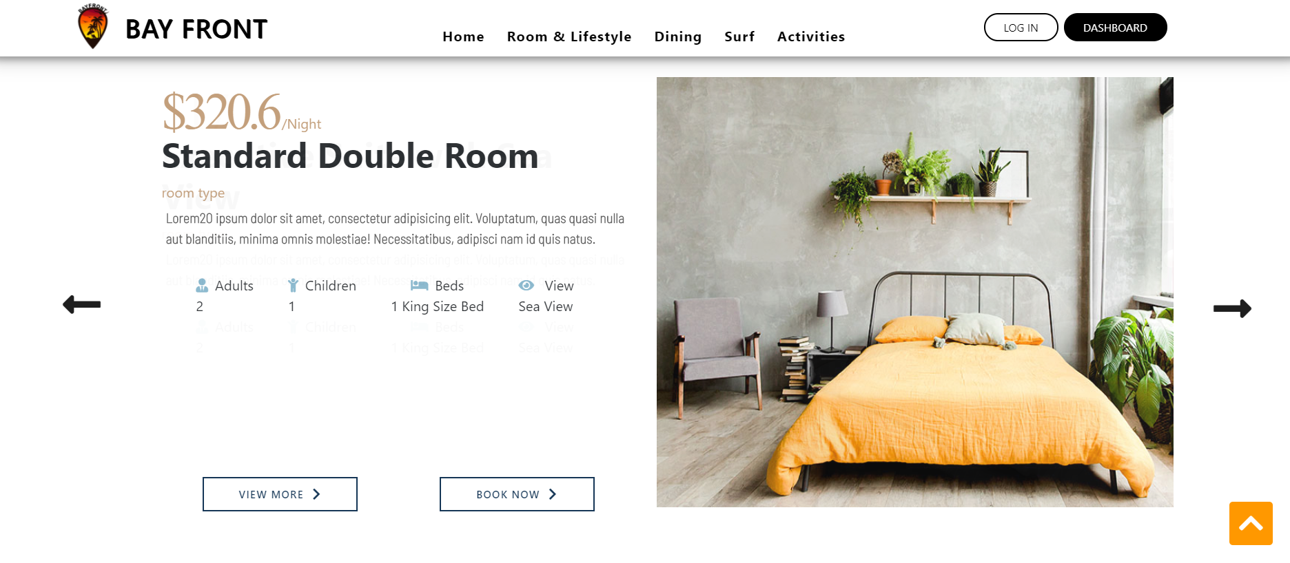
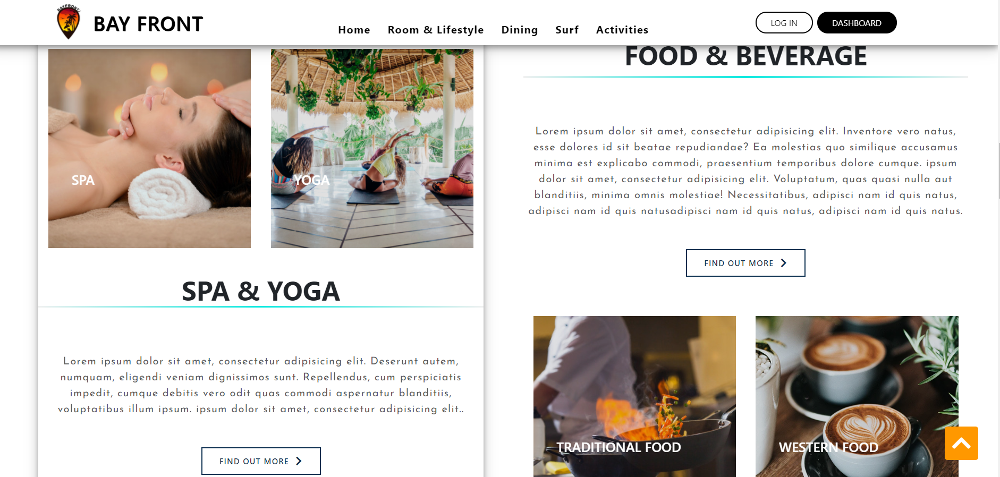
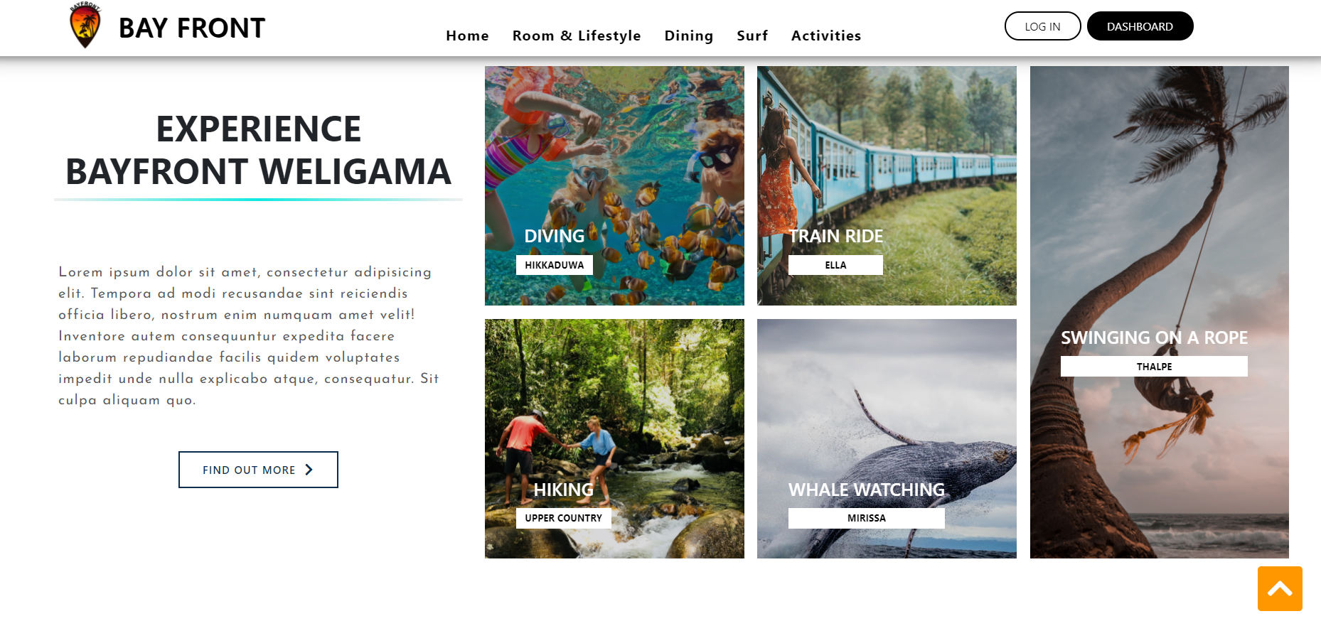
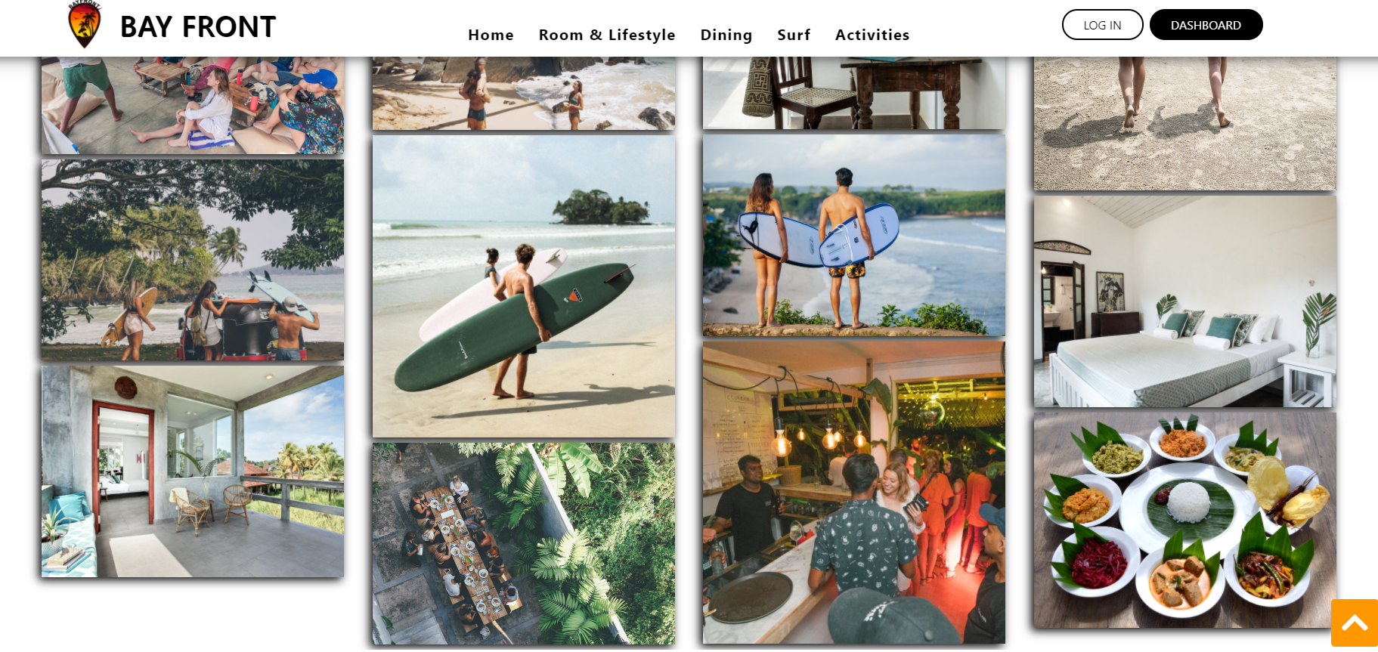

Slide 14
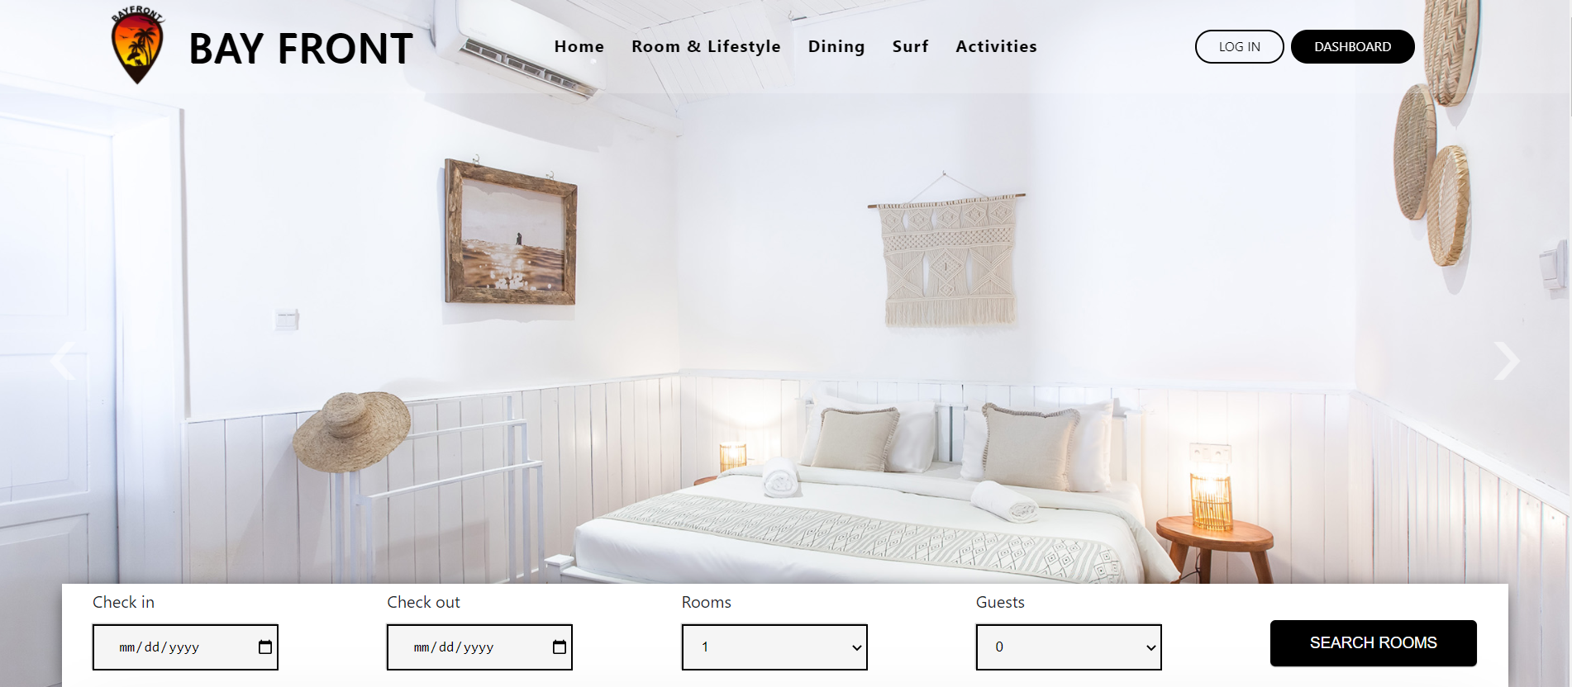
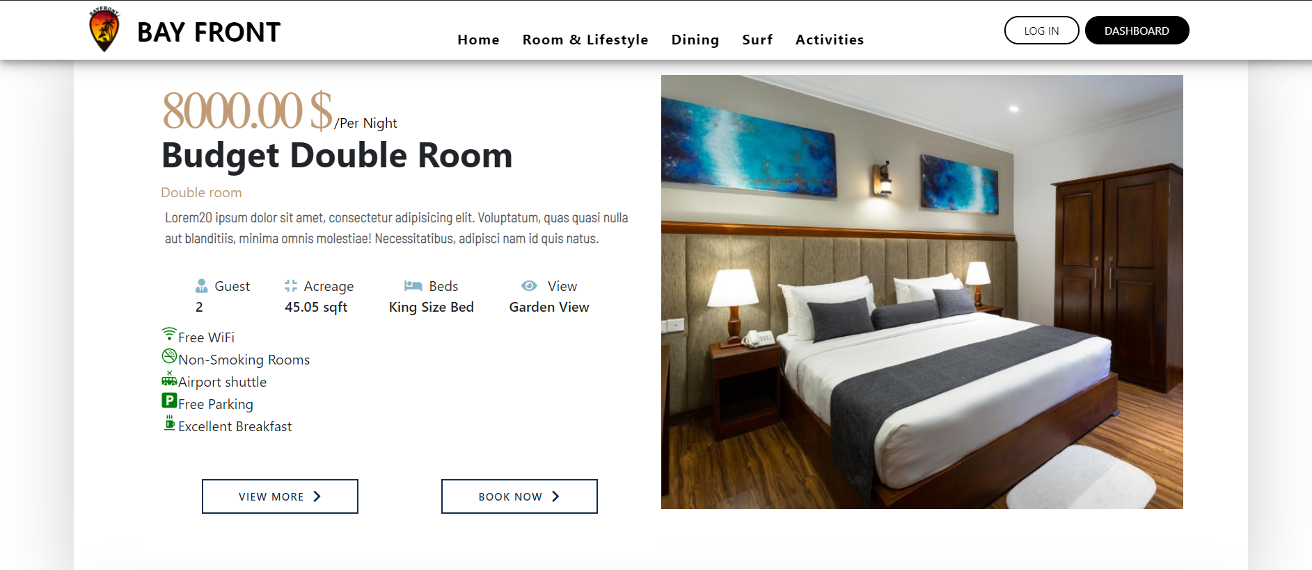
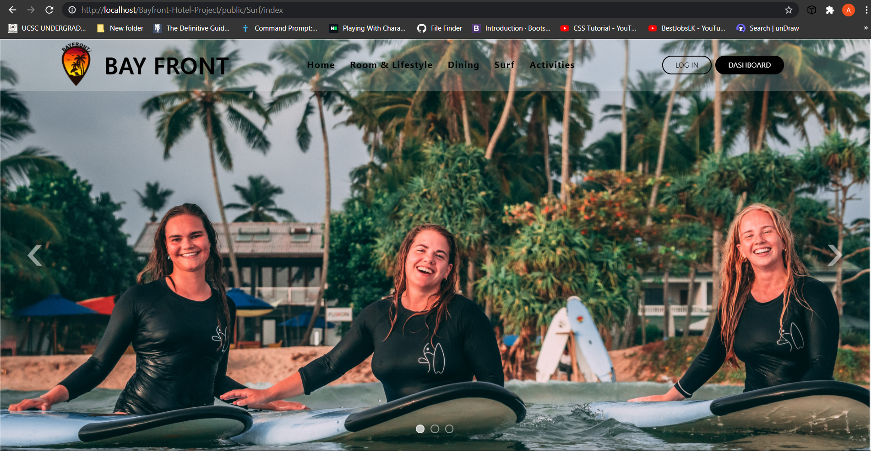
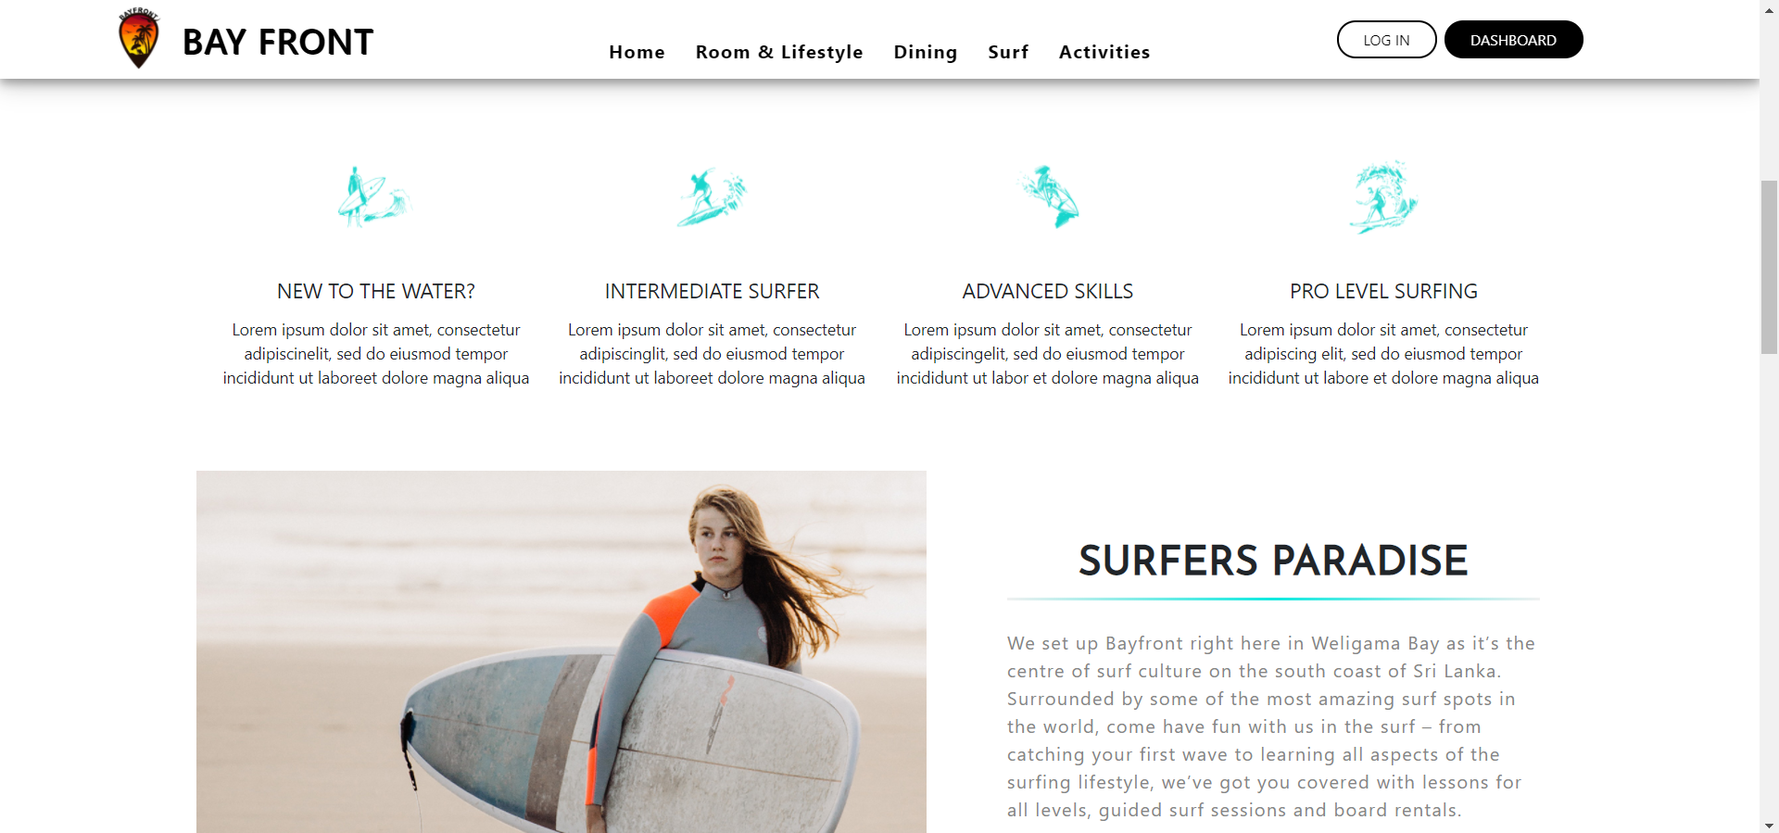

Slide 15
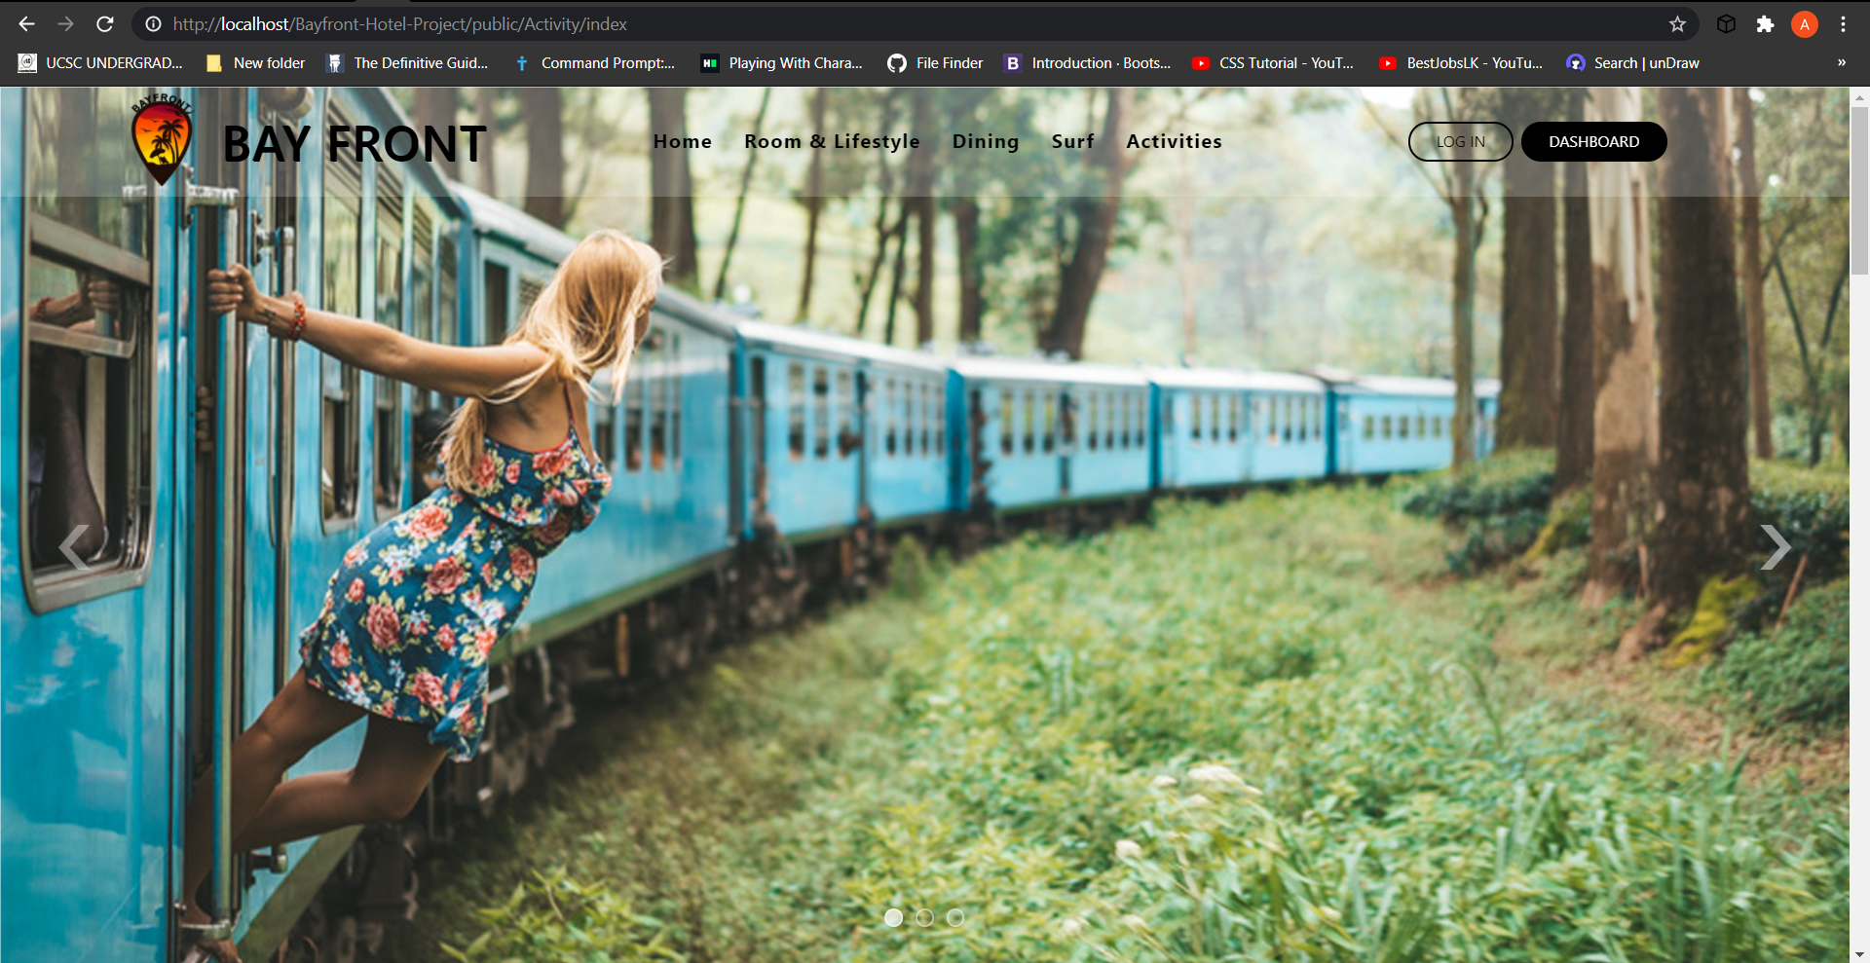
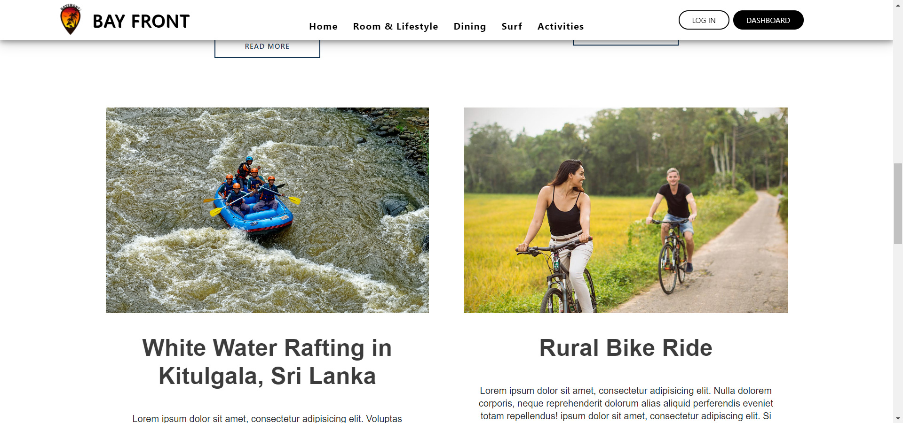
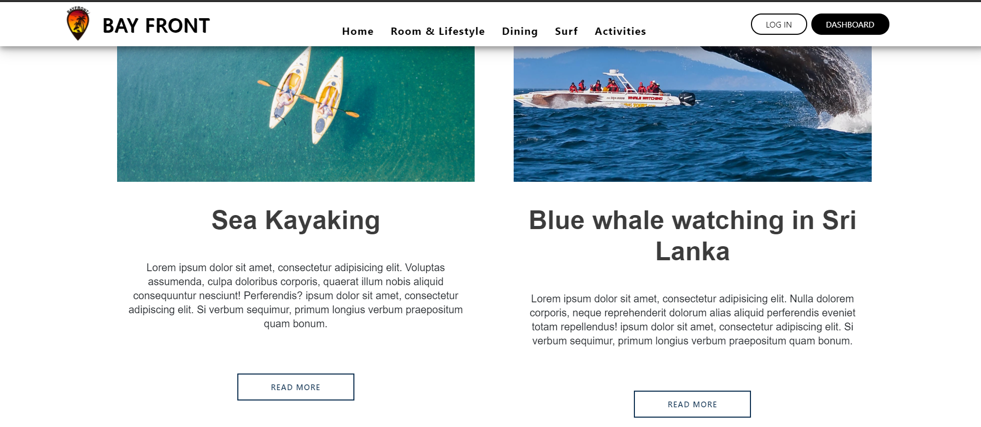
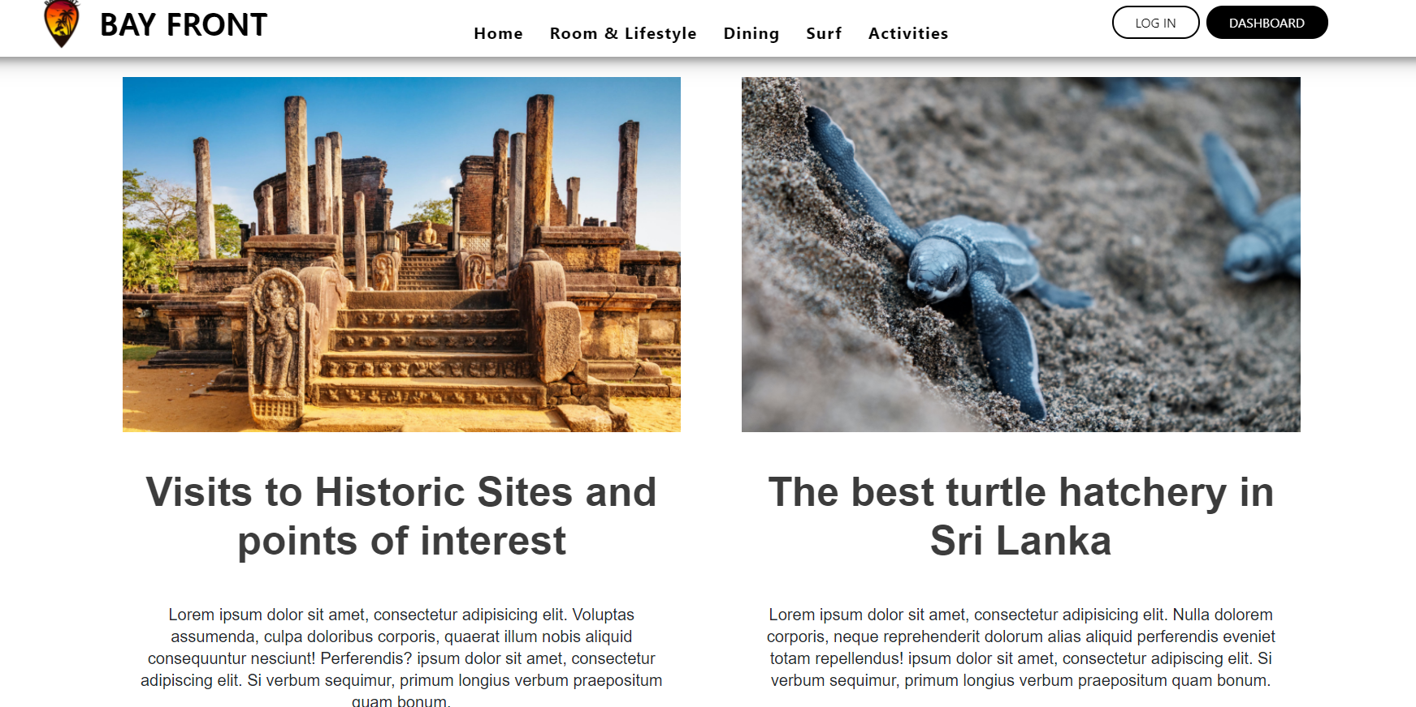

Slide 16
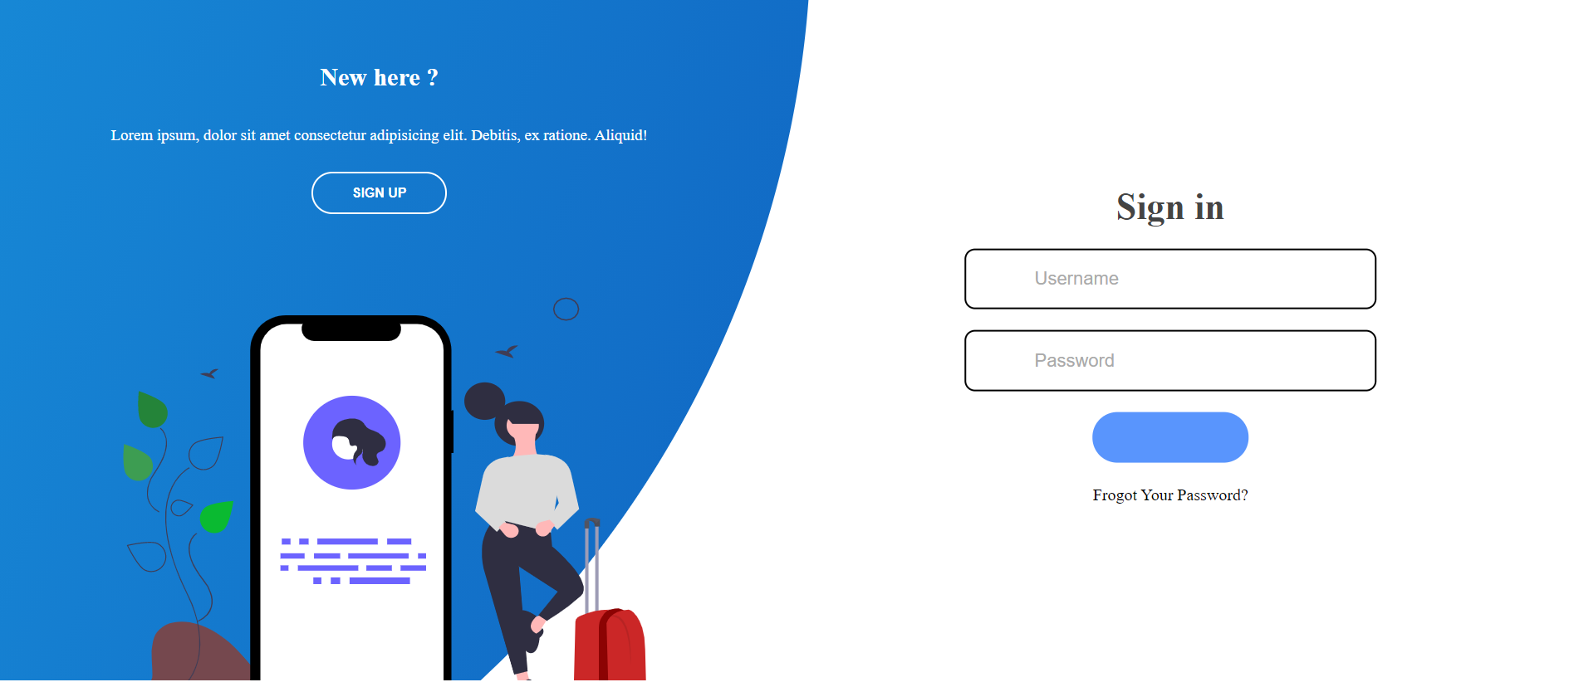
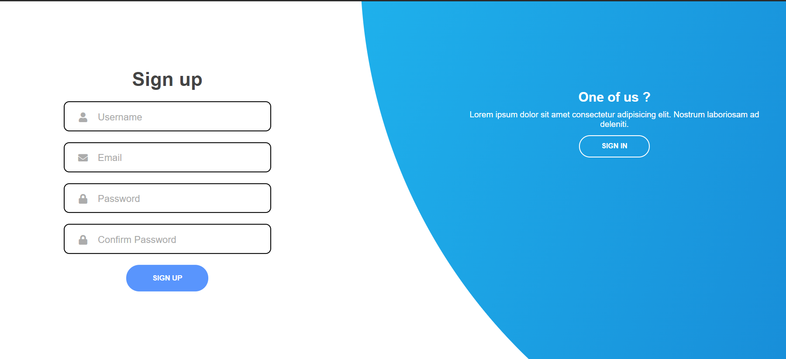
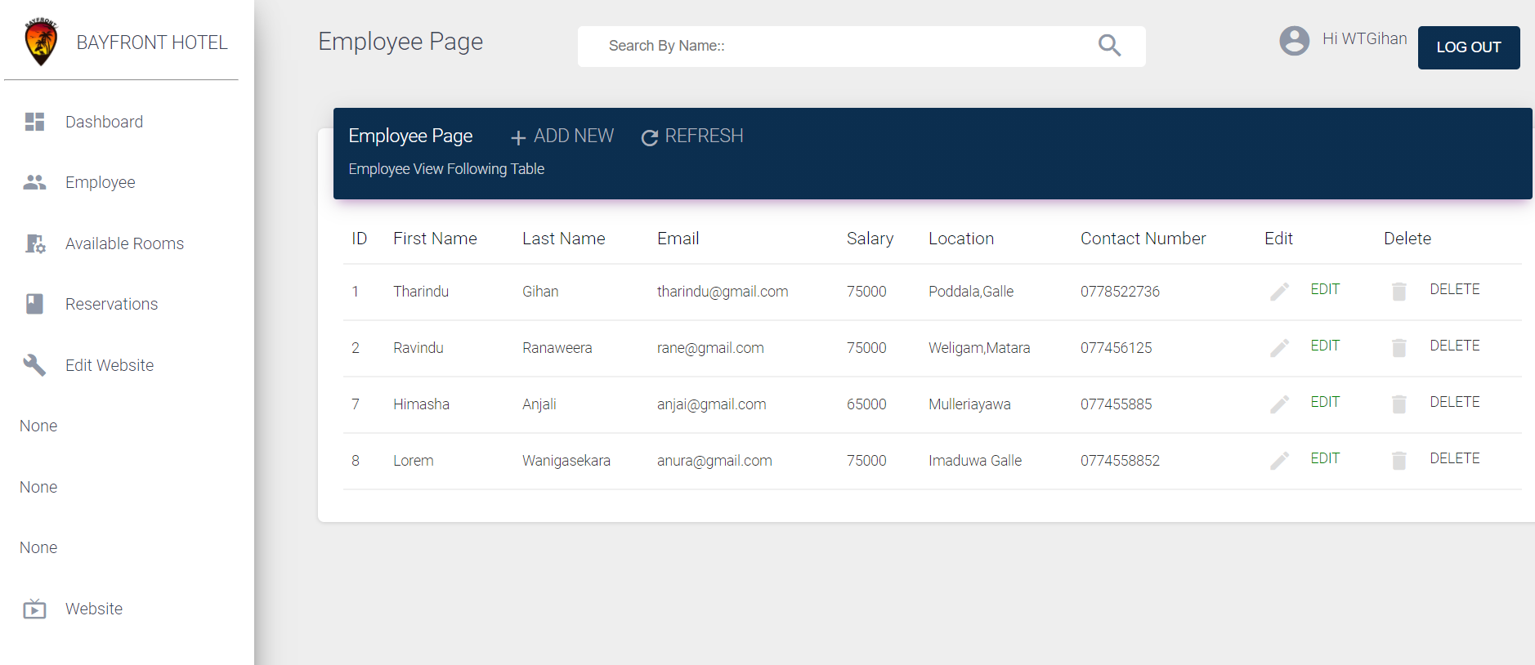
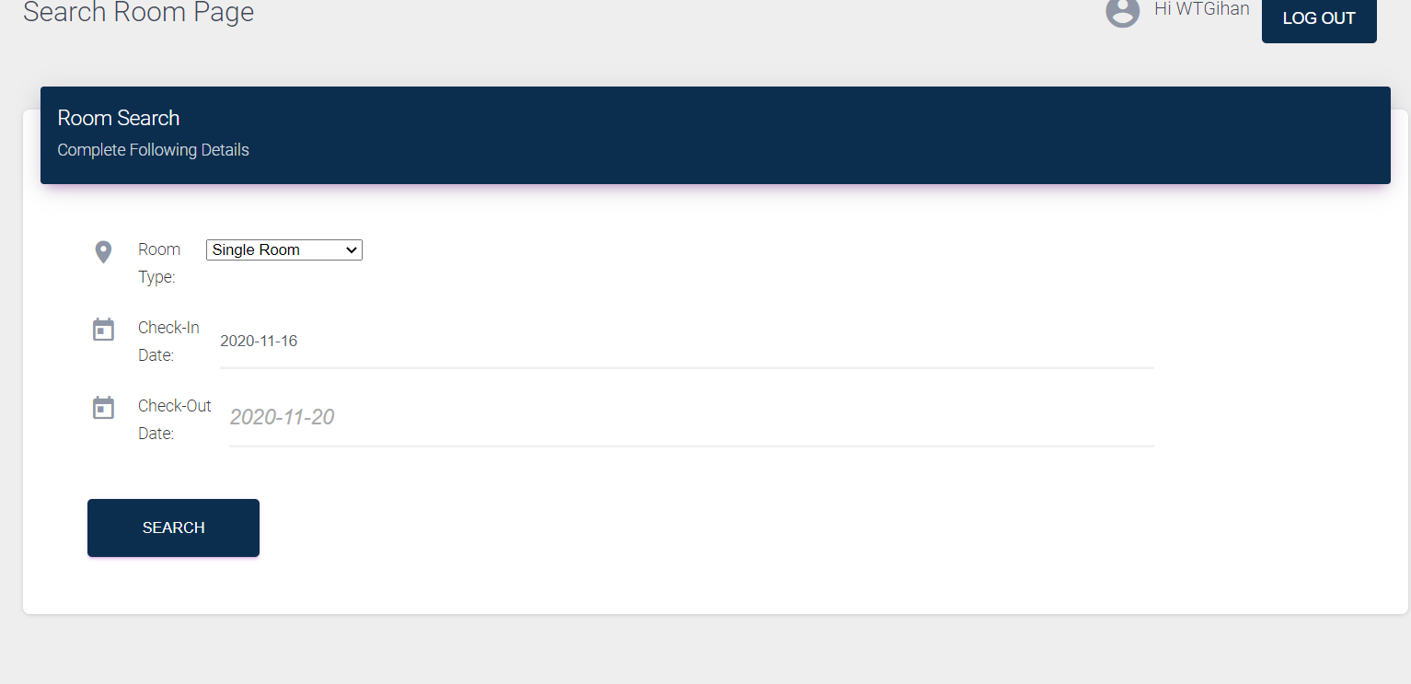

Slide 17

Functional Requirements

Slide 18

Owner/(Admin)
Log in website
It can access the static web pages on the web application.
Edit the website
Manage employee details
Generate summary reports

Slide 19

Receptionist
Log in website
can access the static web pages on the web application.
Handle the walk-in guest
Monitor the cash payment
Handle the booking process

Slide 20

Unregistered Customer
Create customer account
It can only access the static web pages on the web application.
Home
Rooms & suites
Dining
Surf packages
Gallery
About us
Contact
Guest review

Slide 21

Registered Customer
Log in website
can access the static web pages on the web application.
Reserving room
Ability to cancel the booking
Ability to change room
Ability to extend the reservation period
Reserving surfing package
Ability to change package
Online payment facilities
Give feedback

Slide 22

Technical Exposure

Slide 23

What We Learnt ? .

Slide 24





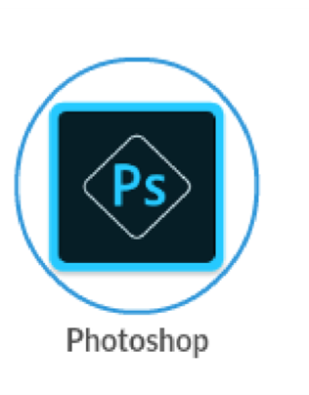



What We Used ?

Slide 25

Member Contribution

Slide 26

Progress So Far . . .
Progress So Far . . .
85 % of the User Interfaces have been developed
30 % of the initial development completed
75 % of the Website Designing
Online Reservation
Edit Website
User Login
Employee Management are fully completed.

Slide 27

Yet To Go . . .
Online Payment Handling
Report Generation
Feedback System

Slide 28

Quality Assurance

Slide 29
Quality Assurance
External Quality (Visible to Users)
Functionality
Usability
Reliability
Security

Slide 30
Quality Assurance
Functionality
We have taken care to implement all the functions to meet the requirements
Every function is subjected to testing to ensure that the work as intended
This system can hold onto data to be used securely

Slide 31
Quality Assurance
Reliability
Completely reliable with proper backup
Security of the system is ensured
Usability
User friendly interfaces
Documentation is provided with complete instruction manual

Slide 32
Quality Assurance
Security
Hashing is used to store passwords
Access is restricted in some components
SQL injection is taken care of using Character-Escaping function and with mysqli_prepare(), bind() and execute() methods

Slide 33
Quality Assurance
Internal Quality (Invisible to Users)
Data Validation
Understandability

Slide 34
Quality Assurance
Validation
Functions are included to validate data such as email, contact number etc.
Understandability
Naming Conventions
Snake Case notation and meaningful names for the functions.
Comments for the source code
Simple and meaningful comments

Slide 35
Testing
We are planning to use “Selenium” for testing

Slide 36

Deployment Plan…

Slide 37
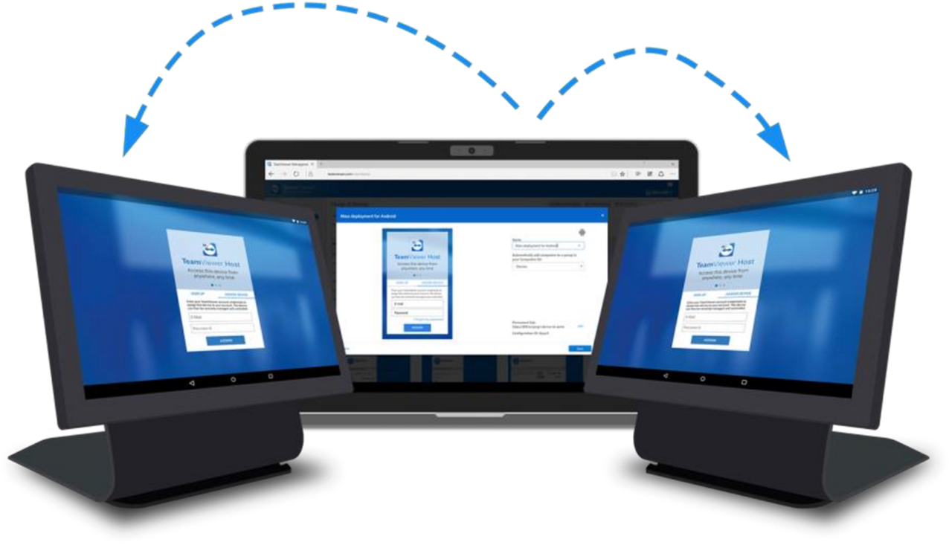
Deployment plan…
Will be hosted in a server
User Training
Documentation on how to use the product (User Manuals etc.)

Slide 38
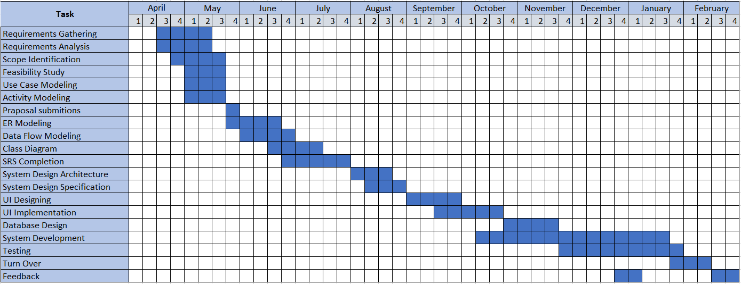
Grant Chart

Slide 39
Individual Contribution
Name | Component
R.P.Ranaweera | In charge of the front end developing Rooms and Lifestyles page Login and Authentication with full stack development Website content Editing with full stack development.
W. T. Gihan | In charge of the back end developing dashboard Dining page Reservations management system with full stack development
G.G.N.N.Wanigasekara | Activity page Home page Website content Editing with full stack development.
H. M. D. Thathsara | Surf page Home page Employee management system with full stack development.

Slide 40
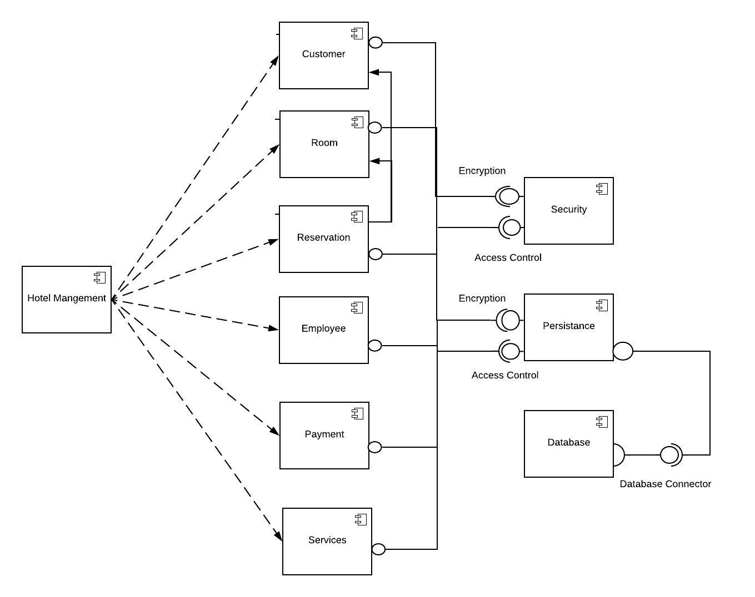
Component Diagram

Slide 41
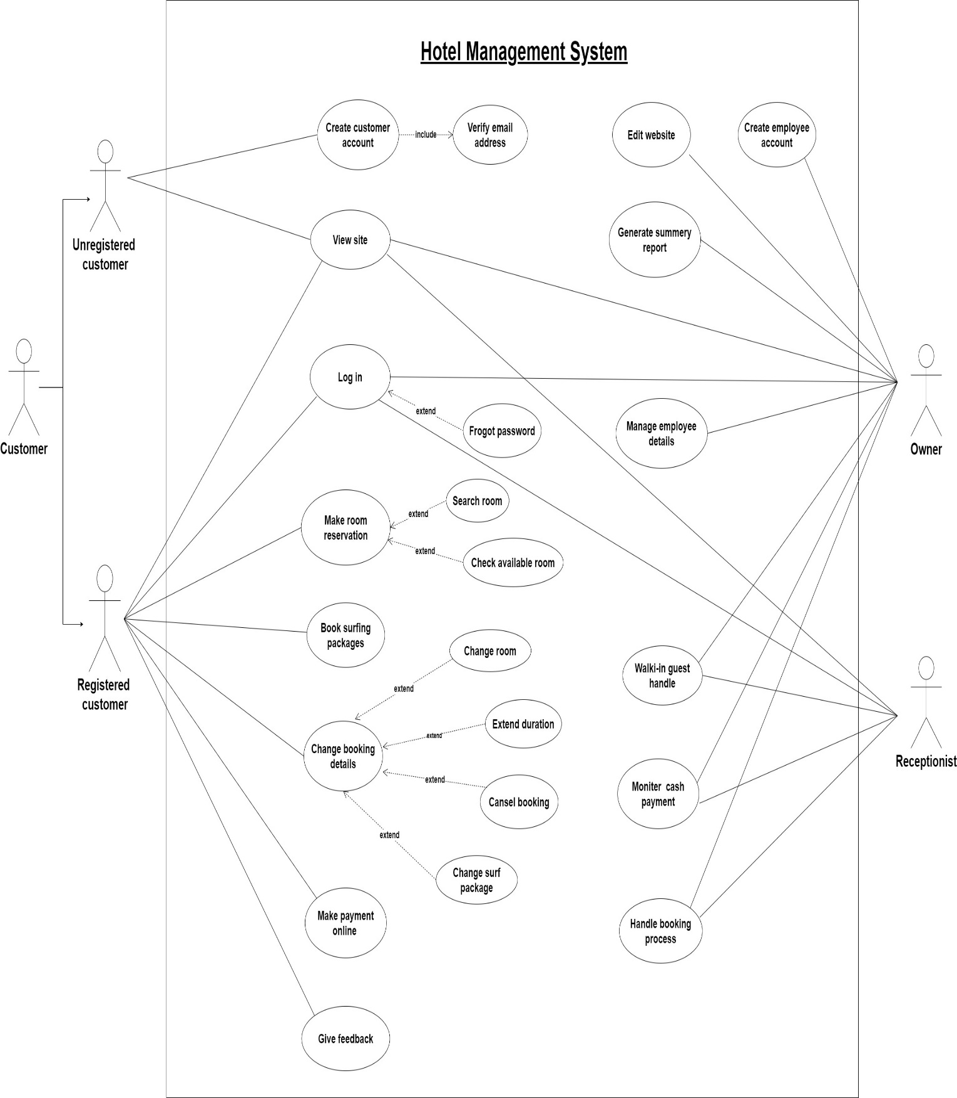
Use case Diagram

Slide 42
Unregistered Customer

Slide 43
Registered Coustomer

Slide 44
Owner/(Admin)

Slide 45
Receptionist

Slide 46

Demonstration

Slide 47

THANK YOU
Insert Image

Slide 48


